Slide 1
The Python Math Library
Samuel VanderZee

Slide 2
Simple to Use
Simply type “import math” into Python
There are many simple, yet useful math functions in this library. Using these functions allows us to write other functions and perform tasks that might be quite hard otherwise
This presentation will introduce many of the functions in the math library, and I’ll also share some functions I wrote that make use of these functions.
I enjoy numbers, so many of my examples are number-theory related. But I will also share more practical uses, and I’m sure you’ll find many practical, statistical uses of the math library!
I’m very new to Python, but found writing mathematical functions that make use of the built-in functions from the math library to be a great way to learn basic function writing in Python

Slide 3
The gcd function
gcd(a, b) returns the greatest common divisor of two integers, a & b.
This function can be used to write more complex functions
Euler’s Totient Function is a function that counts the positive integers up to n that are relatively prime to n (see next page).

Slide 4
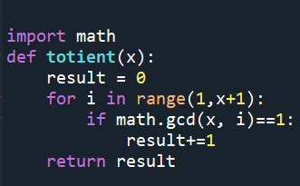
Euler’s Totient Function in Python using the gcd function
I wrote the following function in Python, which makes use of the built-in gcd function from the math library, to compute the totient of a number:

Slide 5
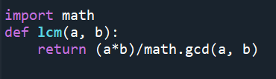
Creating an lcm function from the gcd function
While the math library does not contain a least common multiple function, it is easy to build our own lcm function from the gcd function (simply using a proven fact about lcm)!

Slide 6
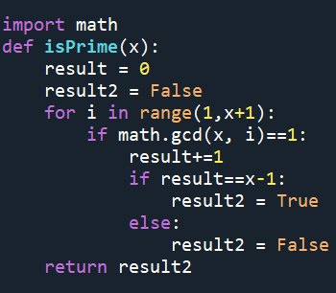
Creating an isPrime function from the gcd function
I built the following simple function to return a Boolean True or False and check if a number is prime. This is another useful usage of the gcd function!

Slide 7
The fsum function
The fsum function can be used to calculate a more precise sum of numbers, for instance, the code: print(sum([.2, .2, .2, .2, .2, .2, .2, .2, .2, .2])) prints 1.9999999999999998, which is not correct.
The code print(math.fsum([.2, .2, .2, .2, .2, .2, .2, .2, .2, .2])) prints 2.0, which is correct.

Slide 8
The math.ceil & math.floor functions
math.ceil(x) returns the smallest integer greater than or equal to x (this could be useful in calculating necessary sample sizes that meet type I and type II error probability requirements (alpha and beta), as will be illustrated on the next slide)
Likewise, math.floor(x) returns the largest integer less than or equal to x

Slide 9
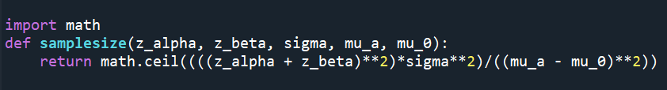
Creating our own sample size function for an upper-tail alpha-level test using the math.ceil function

Slide 10
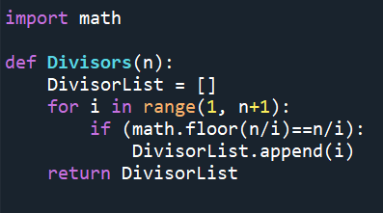
Creating a divisors function from the floor function
Using the built-in math.floor function, I created a simple function that returns a list of the divisors of a number:

Slide 11
Expanding on the divisors function to build a number type function
If the sum of a number’s divisors is less than two times the number, it is called a deficient number. If the sum of a number’s divisors is equal to two times the number, it is called a perfect number, and if the sum of a number’s divisors is greater than two times the number, it is called an abundant number (yeah, I like number theory).
I expanded on the previous divisors function to create a numbertype function, which implements the fsum function in the math library as well (see next slide). Together, the two functions I wrote on the next slide use two functions from the math library that we already discussed (math.floor & math.fsum)

Slide 12
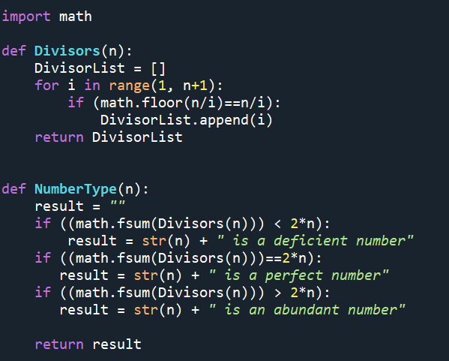
My NumberType Function (uses my divisors function)

Slide 13
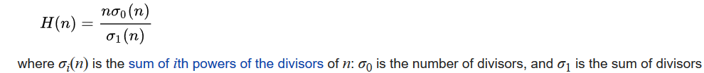
More fun with numbers
A harmonic divisor number (or Oystein Ore number) is a positive integer whose divisors have a harmonic mean that is an integer.
The harmonic mean of the divisors of a number n is defined as:

Slide 14
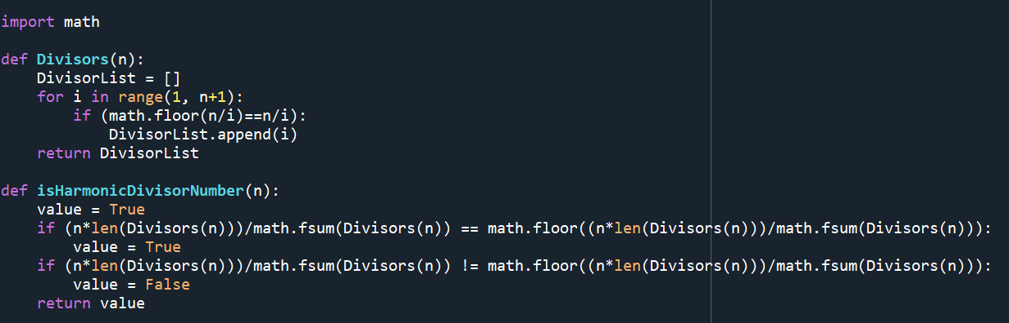
Finding Harmonic Divisor Numbers with Python
I wrote the following function to find Harmonic Divisor Numbers. Note it uses my divisors function, as well as math library functions:

Slide 15
The Square Root Function
math.sqrt(x) returns the square root of a number
This alone may not seem impressive, however, like other simple built-in functions, we can use this function to develop more functions
The following page contains a function I wrote using the math.sqrt function to determine if a triangle is a right triangle given the side lengths

Slide 16
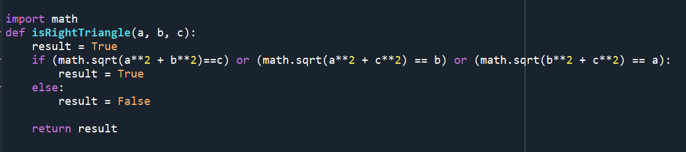
A function I wrote to determine if a triangle is a right triangle using math.sqrt

Slide 17
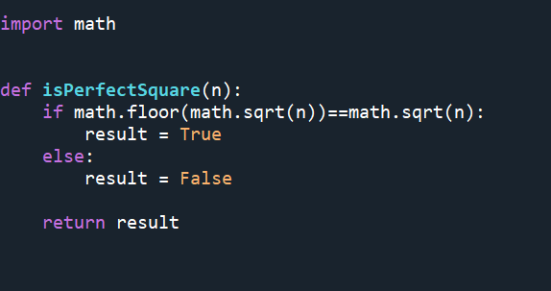
Another application of the sqrt function
Suppose we want to write a simple function to determine if a number is a perfect square. We can implement the math.sqrt function and math.floor function to build the function:

Slide 18
The combinations function
math.comb(n, k) returns the number of ways that k items can be chosen from n items. When k > n it returns 0. Of course, the inputs must be non-negative integers.
This could be very useful in quickly calculating probabilities and other statistics-related questions

Slide 19
More interesting functions
The math.copysign(a, b) function returns a float with the absolute value of a, but the sign of b.
The math.fabs(a) function returns the absolute value of a.
The math.factorial(a) function returns the factorial of a non-negative integer a.

Slide 20
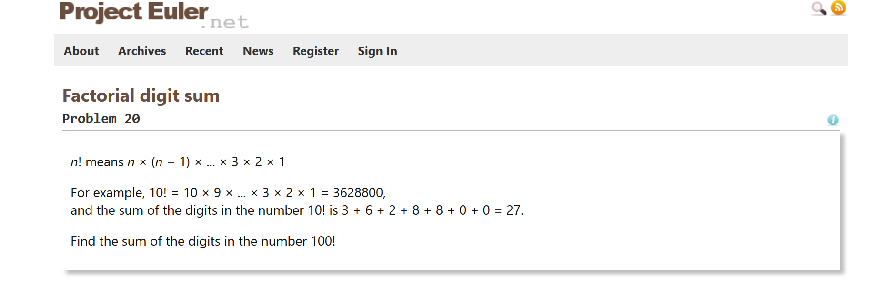
Applying the math.factorial & math.fsum functions to solve a problem:
The problem:

Slide 21
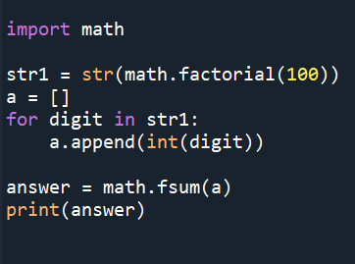
The solution:
I solved the problem utilizing two functions from the math library in the following way. This code yields the correct answer of 648:

Slide 22
The math.dist function
math.dist(x, y) returns the Euclidean distance between two points x & y, where each are given as a sequence of coordinates. It is necessary for the two points to have the same dimension.

Slide 23
The math.pow function
math.pow(a, b) returns a raised to the power b.

Slide 24
The math.pi function
math.pi returns pi to available precision. We can use this to write a simple function to find the area and circumference of a circle:
import math
def Circle(radius):
return "the area of a circle with radius " + str(radius) + " is " + str(math.pi*(radius**2)) + " and the circumference is " + str(2*math.pi*radius)

Slide 25
Trigonometric Functions
There are many trigonometric functions in the math library (note asin means arcsin, etc. while math.atan2(x, y) returns the arctangent of x/y. All results are returned in radians.
-math.cos(x)
-math.sin(x)
-math.tan(x)
-math.asin(x)
-math.acos(x)
-math.atan(x)
-math.atan2(x, y)

Slide 26
Hyperbolic Trigonometric Functions
math.acosh(x) returns the inverse hyperbolic cosine of x
math.asinh(x) returns the inverse hyperbolic sine of x
math.atanh(x) returns the inverse hyperbolic tangent of x
math.cosh(x) returns the hyperbolic cosine of x
math.sinh(x) returns the hyperbolic sine of x
math.tanh(x) returns the hyperbolic tangent of x

Slide 27
Angular Conversions
math.degrees(x) takes in an angular measurement x in radians and returns its measurement in degrees
math.radians(x) takes in an angular measurement x in degrees and returns its measurement in radians

Slide 28
The math.isclose function
math.isclose(x, y) returns True or False depending on whether the values of x and y are “close.” The function also allows the user to specify rel_tol and abs_tol, that is, relative and absolute tolerance. Relative tolerance is the maximum allowed difference between x and y, relative to the larger absolute value of x and y. For instance, a tolerance of 1% would be specified as rel_tol = 0.01. Absolute tolerance, specified as abs_tol is the minimum absolute tolerance, and must be at least 0.
Next slide contains examples

Slide 29
The math.isclose function continued
print(math.isclose(3, 3.000000001)) prints “True” but print(math.isclose(3, 3.00000001)) prints “False.” This is because the default relative tolerance is 10^-9
Experimenting more: print(math.isclose(3, 3.000001, rel_tol=1e-06, abs_tol=0.0)) prints “True” but print(math.isclose(3, 3.00001, rel_tol=1e-06, abs_tol=0.0)) prints “False.” This is because we specified rel_tol = 1e-06

Slide 30

Using the isclose function on an approximation of pi
Leibniz determined that
Let’s employ Python to figure out how many iterations of this series it takes until we get an approximation of pi/4 with a relative tolerance of 0.0001
The code is on the next page followed by the output. As you will see, it took 3183 iterations of the Leibniz formula to approximate pi with a relative tolerance of 0.0001.

Slide 31
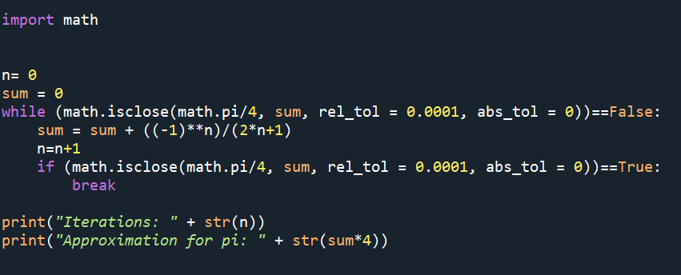

Approximating pi continued (Leibniz formula)

Slide 32


Experimenting with approximating pi to a relative tolerance of 0.0001 using another known summation formula

Slide 33

When approximation takes too long
Let’s try to approximate pi with

Slide 34
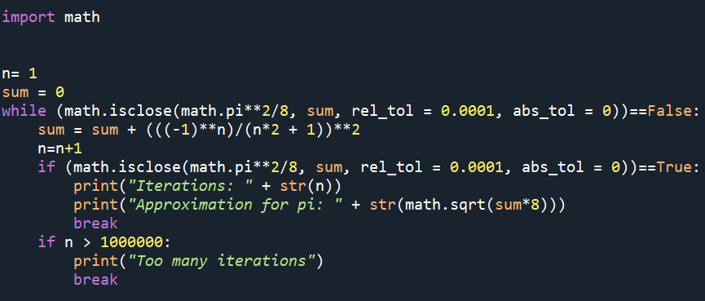
Adding code to control for too many iterations
I added code to stop if the number of iterations exceeds 1000000, and approximating pi using the formula on the previous page gives:

Slide 35
Downsides of the Package & Summary
While the Python math library has a lot of functions, clearly there is a lot that is left out. This can be seen even in this presentation, as I had to write many functions myself to perform math tasks that I was interested in
Nevertheless, the math library is very useful and allows many mathematical operations to be done quickly
I hope you enjoy this package as well, and find other relevant uses of it. I encourage you to explore more at https://docs.python.org/3/library/math.html

